Slide 1

Avian Influenza Investigation: Laboratory Algorithm
**Screening flocks for all influenza viruses using PCR (M) is recommended where possible. Specific virus PCR can be used first e.g. H5 or H7 where a diagnosis is required for a specific virus in an emergency.
Surveillance (Healthy flock): Swab
(Sampling frame/Strategy)
Sick Animal or In-contact flock (Swab / Tissue)
# Avoid pooling samples in the field whenever possible; where it is required for testing purposes, it is best done at the laboratory by combining a maximum of 5 similar samples per pool from the same sample type, species, and epidemiologic unit
Prepare Samples
# Do not pool >5 animals
** PCR (M)
e.g. † AAHL primers & probes
Virus Isolation (3 passages)
& HA
Diagnosis – use one or both tests, with
virus isolation positives also tested by PCR
Surveillance – start with PCR, then
isolate virus from positive sample
NEG
POS
POS
NEG
H Typing HI full titration
* (Specific H type
e.g. H5 or H7) & ND
Report
Differential Diagnosis
(ND, IBD, DVE)
PCR (e.g. H5, H7 or H9)
e.g. † recommended regional SOPs e.g. AAHL/FLI
NEG
POS
POS/NEG
NEG/POS
Differential Diagnosis
(IBD, DVE)
† Use recommended regional PCR primers & probe
Report
PCR (e.g.N9, N6 or N8) e.g. † CNIC primers & probes
POS
POS
* Where screening for H5 or H7 the antigens and antisera in the test must match the circulating H5 or H7 clade or strain. The antiserum used must be specific for the H type (Hyperimmune serum allows detection of all clades with the H type)
NEG
NEG
Report
Further
Characterisation
‡ For confirmation of H & N type the isolate will need sequencing
(e.g. H7N9 from China or H5 clade 2.3.4.6)
REFERENCE LAB
H typing
† PCR/Sequencing
‡ H & N typing (Conformation)
‡ HA & N Gene Sequencing
Further
Characterisation
Further
Characterisation
H & N typing HI
(H & N typing by PCR/Sequencing is the preferred method)
N typing † † .
† PCR/Sequencing
Whole genome Sequencing (Optional)

Slide 2
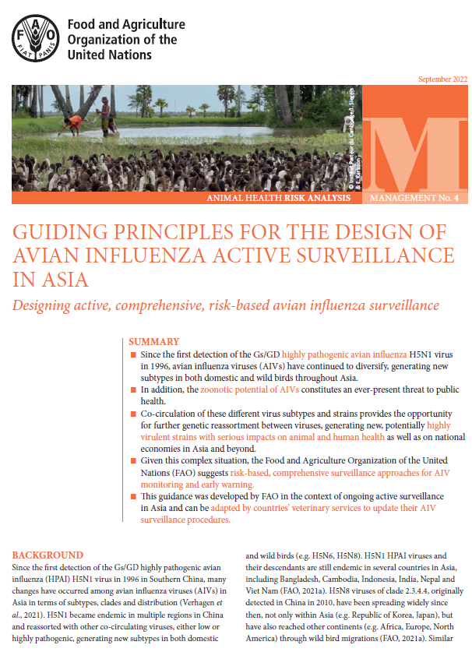
ECTAD Asia and the Pacific (fao.org)
Guiding principles for the design of avian influenza active surveillance in Asia (fao.org)
Home - Offlu

Slide 3
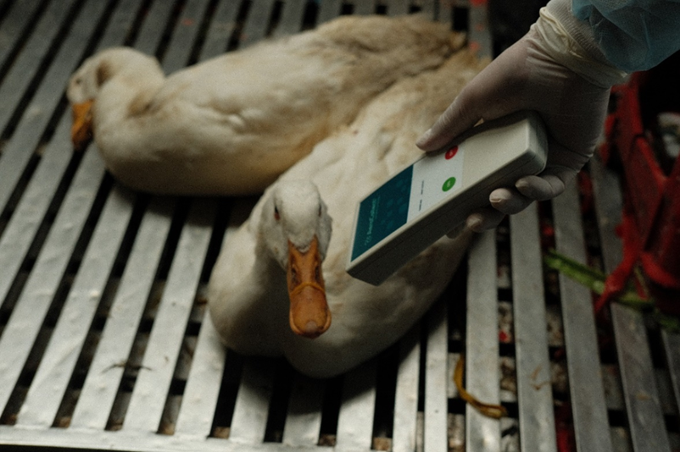
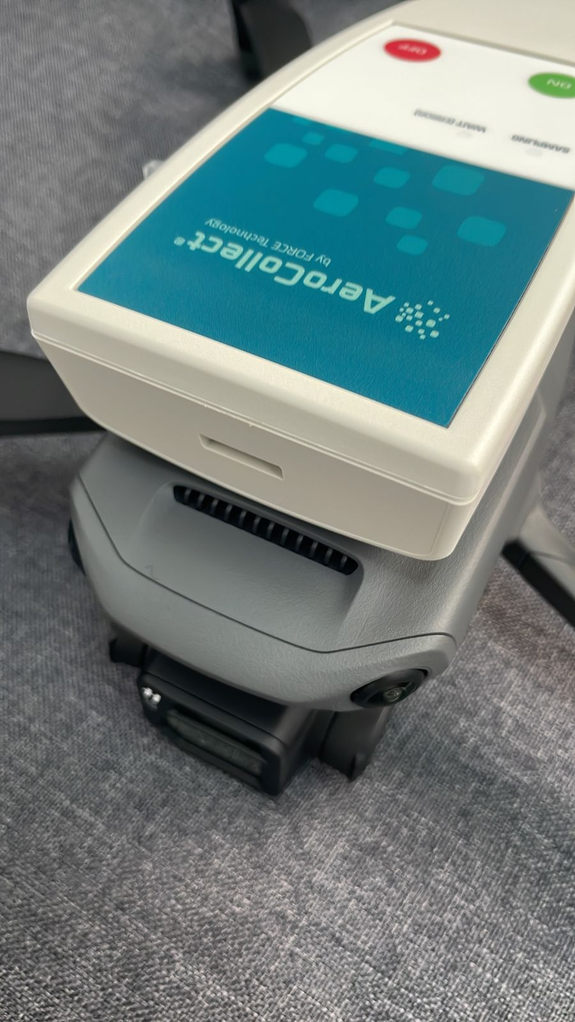
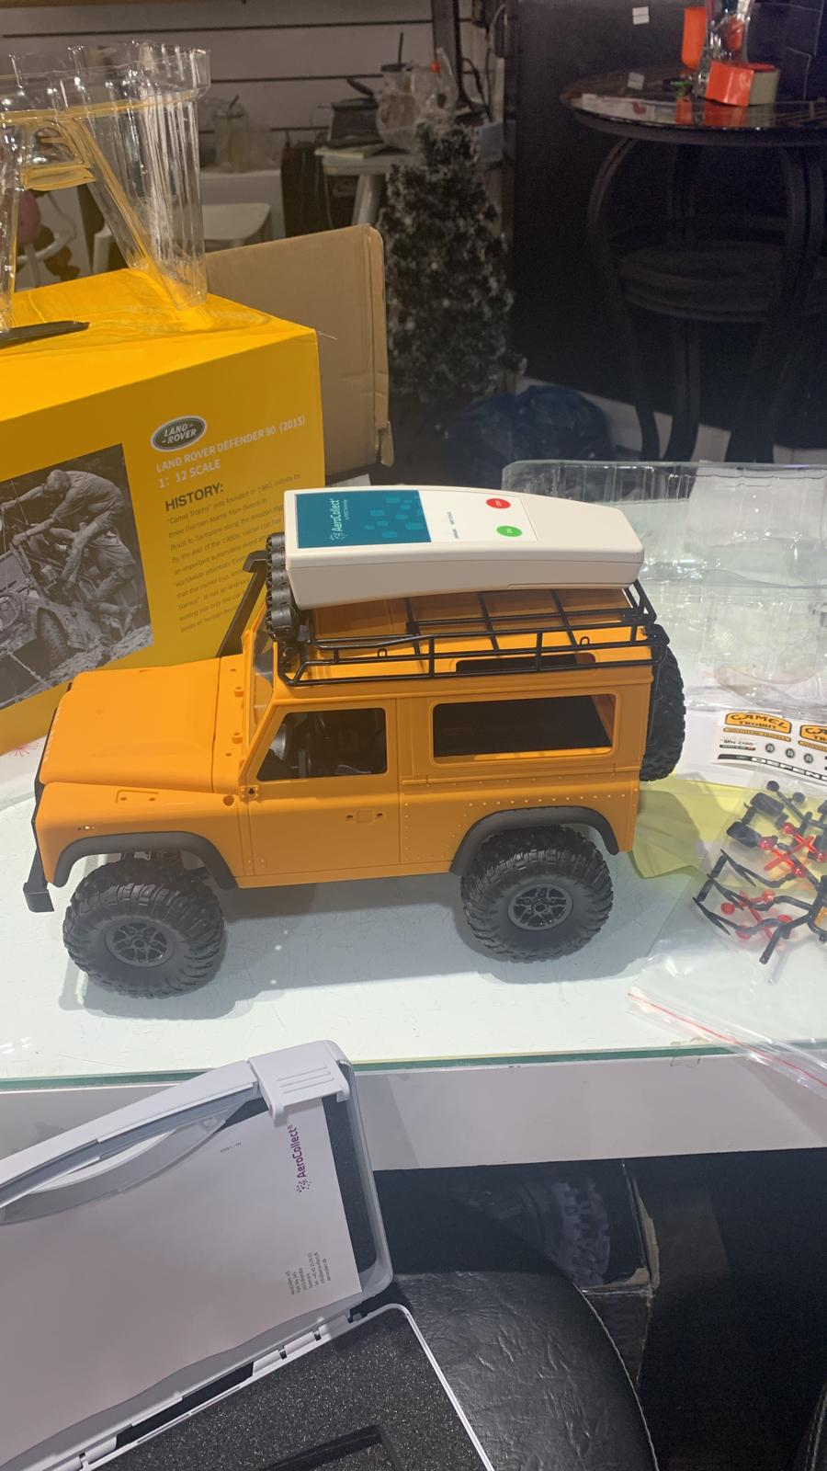
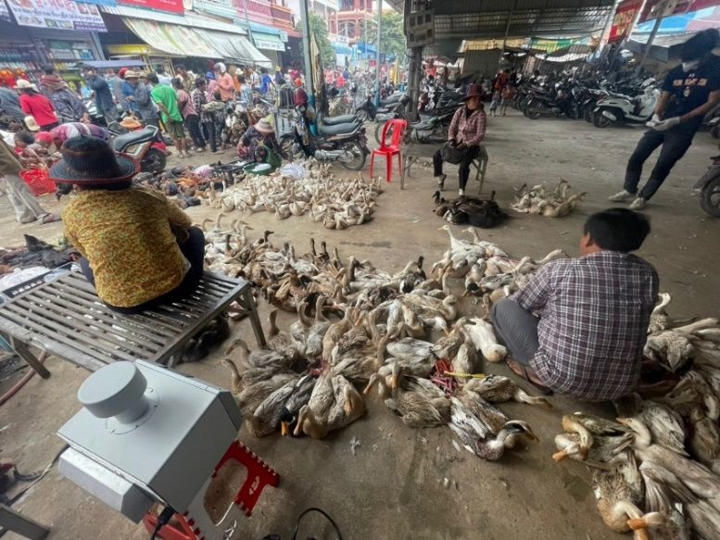

Slide 4
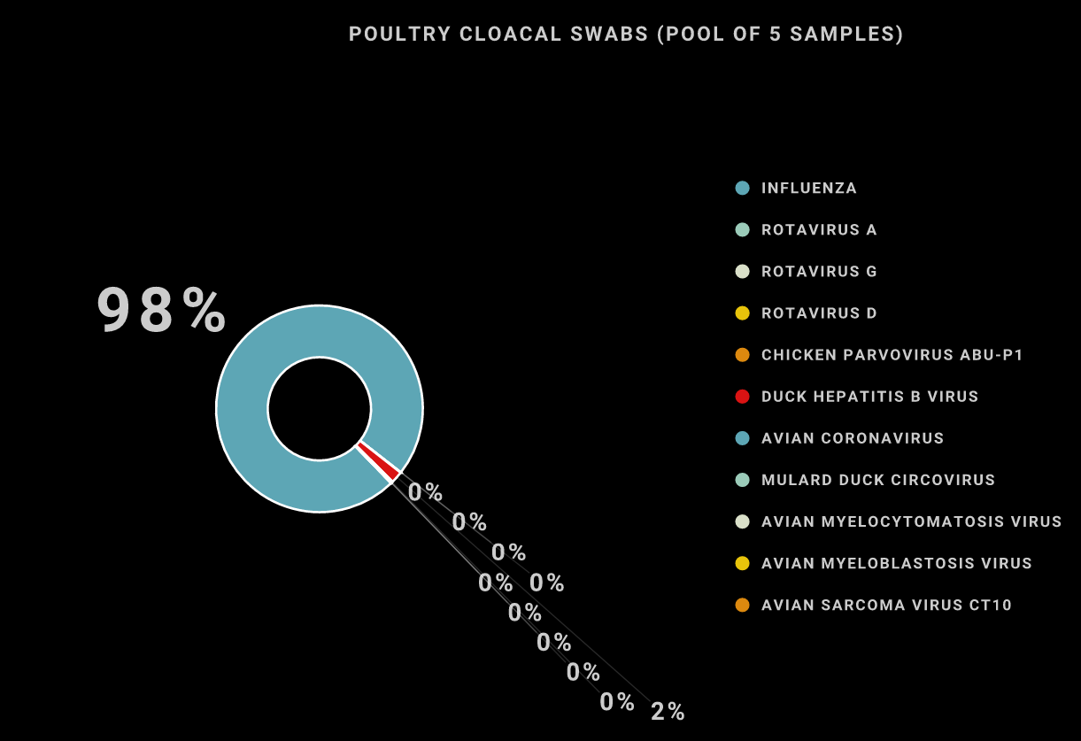
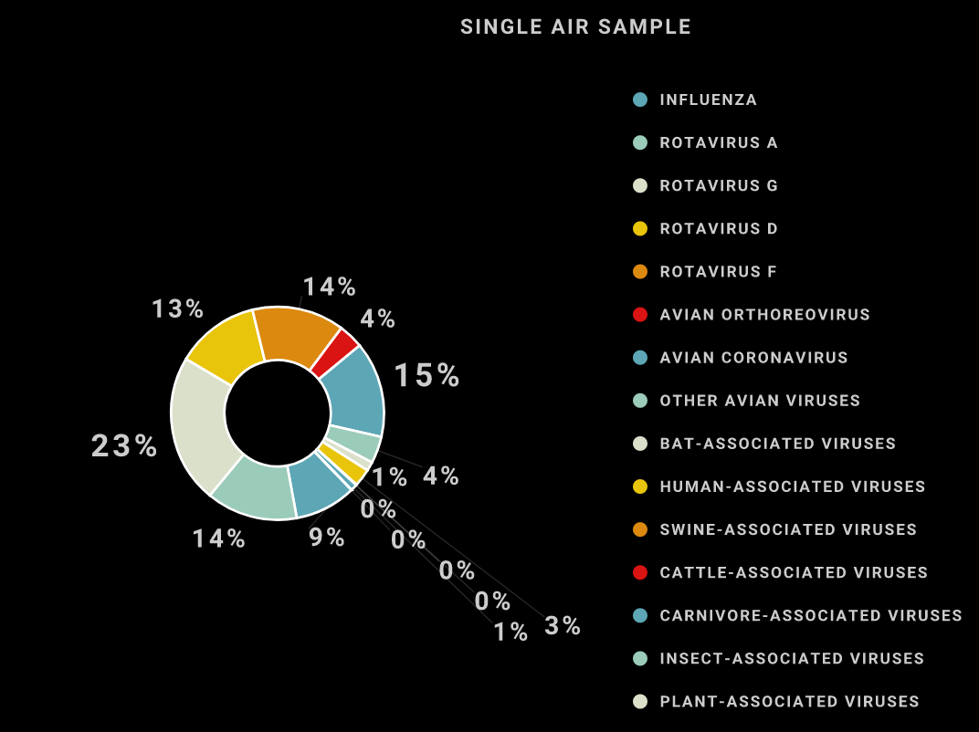

Slide 5
